Slide 1
ADDITIVES VARIANCE CORRECTION REPORT
June 11th, 2026

Slide 2
PROCESS OVERVIEW
Outgoing operators exchange information regarding the dosing unit parameters, temporary changes, and any problems that occurred during the shift with the incoming operator.
Extruder operator informs the Team Lead about the additives needed for the job, the Team Lead then informs the forklift operator to retrieve the additives in the additives area.
The additives are brought to the scale and weighed.
Extruder operator records information and weight of the additives in the additives logbook.
Adjusts infeed time based on dosing percentage.
Extruder operator submerges the suction tube nozzle into each additive.
Occasionally, the extruder operator uses a shovel to fill in cavities created by the suctioning of the vacuum tubes. In the meanwhile, the extruder operators patrol around the extruder to ensure all parts are operating as usual.
A sample is collected for every four-fifths of a box produced.

Slide 3
PROCESS OVERVIEW
The lab provides feedback (if any) on the sample submitted.
The extruder operators inform the on-duty supervisor about the necessary changes and adjusts the dosing percentages based on the feedback given by the lab. Supervisor changes quantity per throughout the job.
At the end of the shift, the additives are weighed again and data regarding the additives will be recorded in the additives logbook.

Slide 4
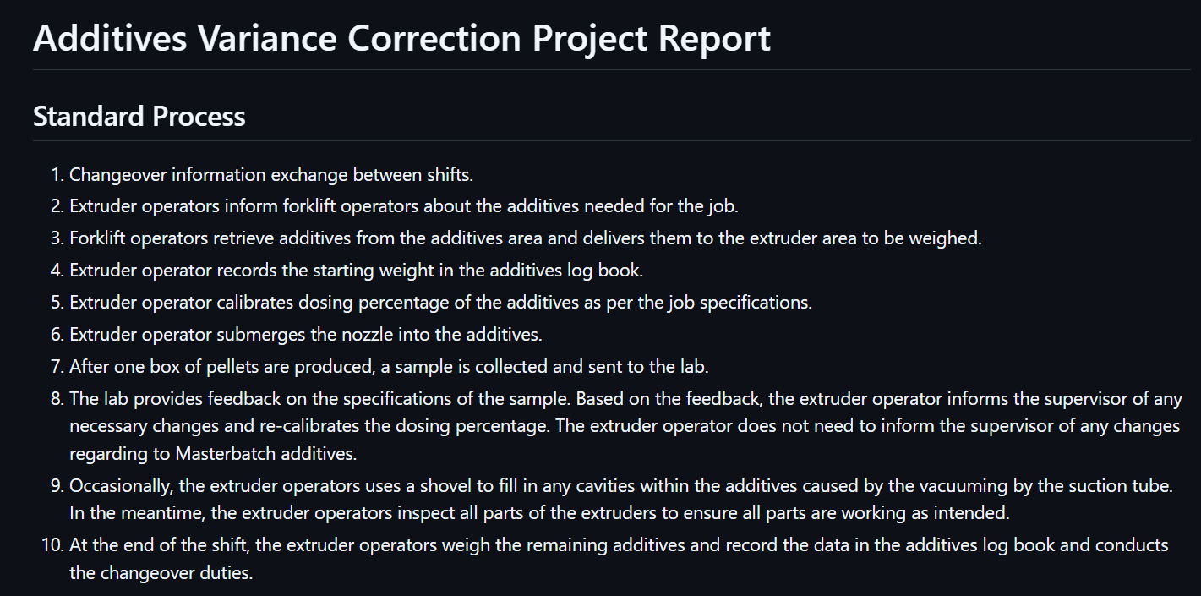
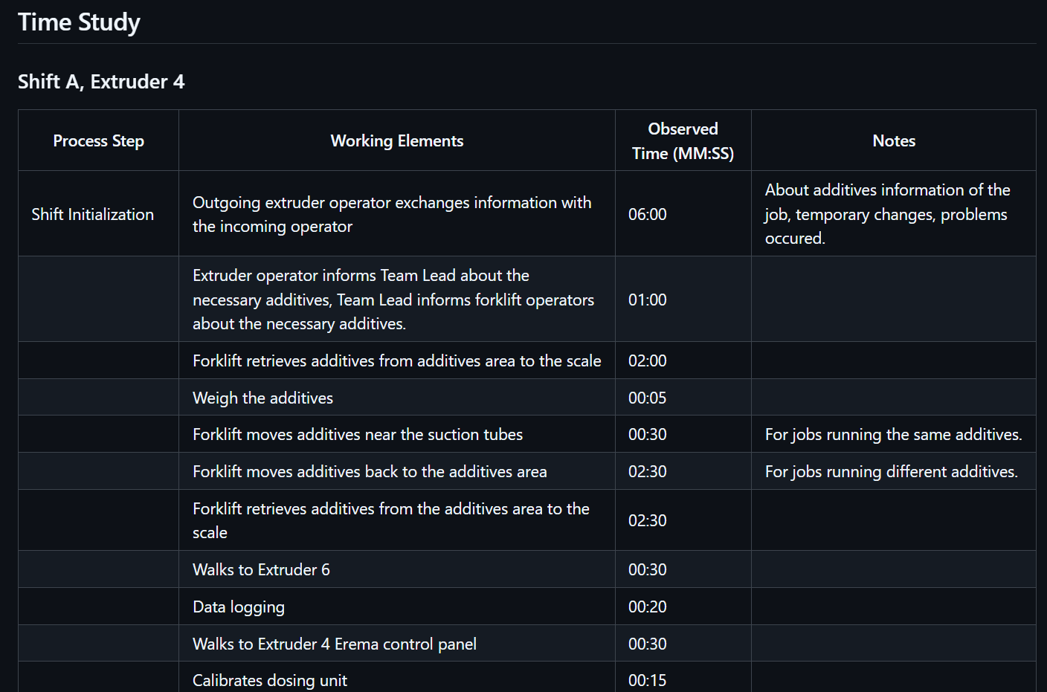
RAW DATA TABLE
Link to Raw Data Table

Slide 5
TIME STUDY

Slide 6
METHOD GAPS
From observation, the extruder operators and crew executed the standard process within an acceptable amount of time.
MASTERBATCH
Extruder operators do not have to notify superiors about changes in Masterbatch dosing percentages.
SEBS
Job requirement issues quantity per at 15%, but the operators run the dosing unit at 18%.
ENG, TPO
Inconsistent measurements for start and end weight. The actual quantity is less than what was recorded on the additives logbook.

Slide 7
METHOD GAPS
Dosing Unit Buffer:
At the end of the shift, there are left-over number of additives within the dosing unit.
The extruder operator issues a label with the weight of the additives box.
The additives within the dosing unit are technically used but produced quantity is not calculated within the shift.
Scrap Material Infeed Ratio:
Some scrap materials have very drastically different properties. For example, some may have very high-melt while others have low-melt.
Currently, there is no method implemented to visually separate scrap materials with different properties. This makes it such that the forklift operators have no choice but to randomly retrieve scrap materials from the floor.
The random scrap materials that are retrieved may contain drastically different properties, leading to an increase in the number of additives used during a job.

Slide 8
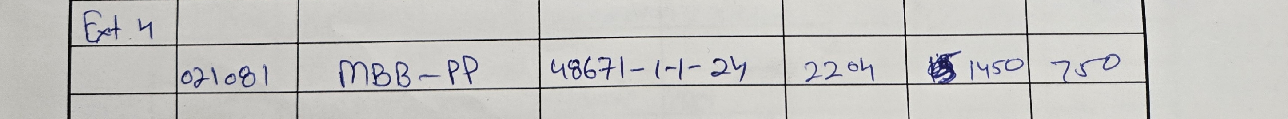
DATA GAPS
Quality Control Lab Feedback:
Currently, there is no method implemented to directly record dosing percentage changes.
It is verbally relayed to the supervisor at the end of the operator’s shift or when the supervisor is on the floor.
As a result, this may create inconsistencies within the data used to calculate expected and actual number of additives used.
Additives Logbook to ERP:
There are some discrepancies between logbook and ERP data for additives.

Slide 9
SUGGESTIONS
Ensure accurate and appropriate measurement and data-logging methods to ensure all data can be representative of production.
Organize and visually separate scrap materials based on their properties.

